Slide 1
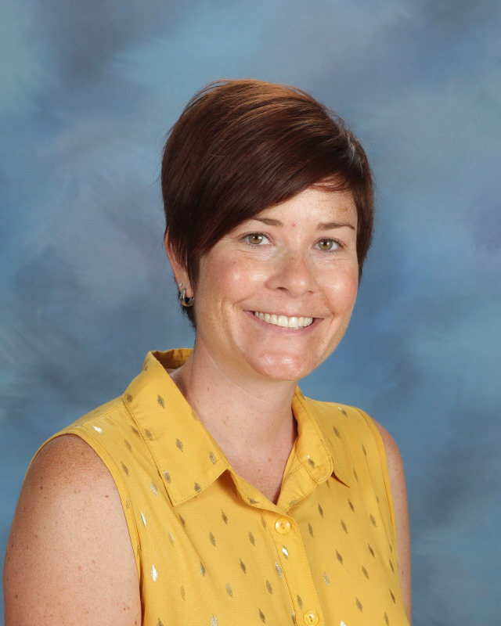

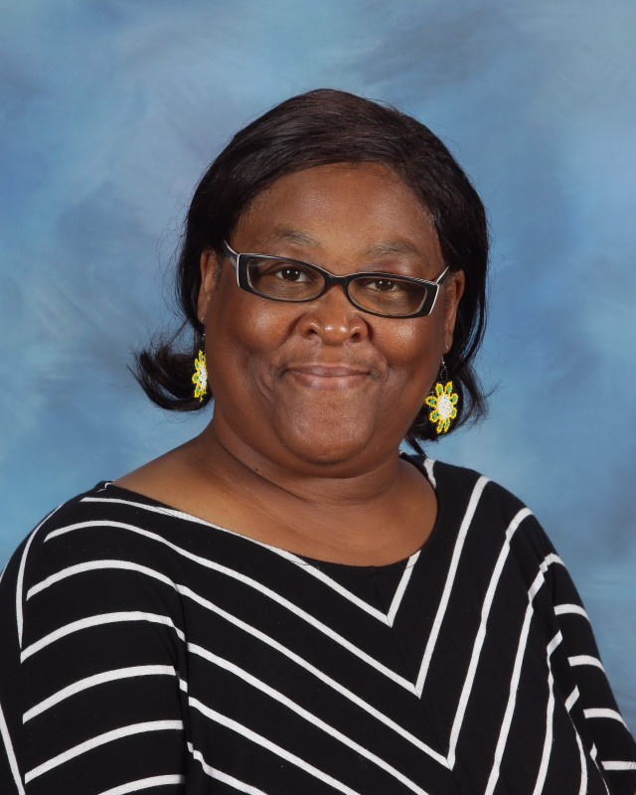
Welcome to Mrs. Cheney and Ms. Norwood’s Classroom.

Slide 2

Getting to Know Mrs. Cheney
I am excited for the 2020-2021 school year at Hesse K-8 School! I want to take this opportunity to introduce myself. I am Regan Cheney and I will be your child’s kindergarten teacher. I am excited to be your child’s teacher this year.
I want to tell you a little more about myself so that you can get to know who your child’s teacher is. I am originally from western Pennsylvania about 1.5 hours north of Pittsburgh – Go Steelers, Penguins and Pirates! I graduated from Grove City College, a private liberal arts college in Grove City, Pennsylvania. I worked in public schools for 10 years in Pennsylvania. Then I moved to Florida with my husband and I taught Kindergarten in Florida for four years. I have lived in Savannah for two years now and I am starting my seventh year of teaching Kindergarten.
During our first few days as a class, we will be going over classroom procedures, routines and activities to get to know one another. . I know that coming to a new class, especially a virtual class, and or new school will be an adjustment for your child. The kindergarten team and I will be planning and collaborating together to make this change to a new school year a smooth transition for your child as well as a fantastic year.
Again, I am so excited to be your child’s kindergarten teacher! If you have any questions or concerns please do not hesitate to send me an email me. I look forward to a wonderful school year!

Slide 3



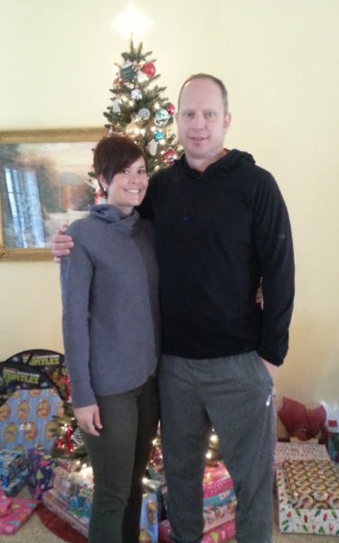


Mrs. Cheney Likes:

Slide 4
Getting to Know Ms. Norwood
I was born in Savannah Georgia and attended Savannah Chatham County Schools. I received a bachelor’s degree in Business Administration from Savannah State University. Later, I attended Georgia Southern University to pursue a degree in Early Childhood.
I enjoy walking, cooking, listening to good music and working with children.
I have three children: Kendra, Kenielle and Kenneth. I have 3 grandchildren: Luca, Wilder and Luna. I love my children, but my grandchildren are the “Loves” of my life.

Slide 5

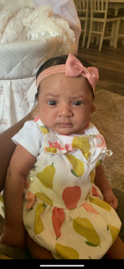
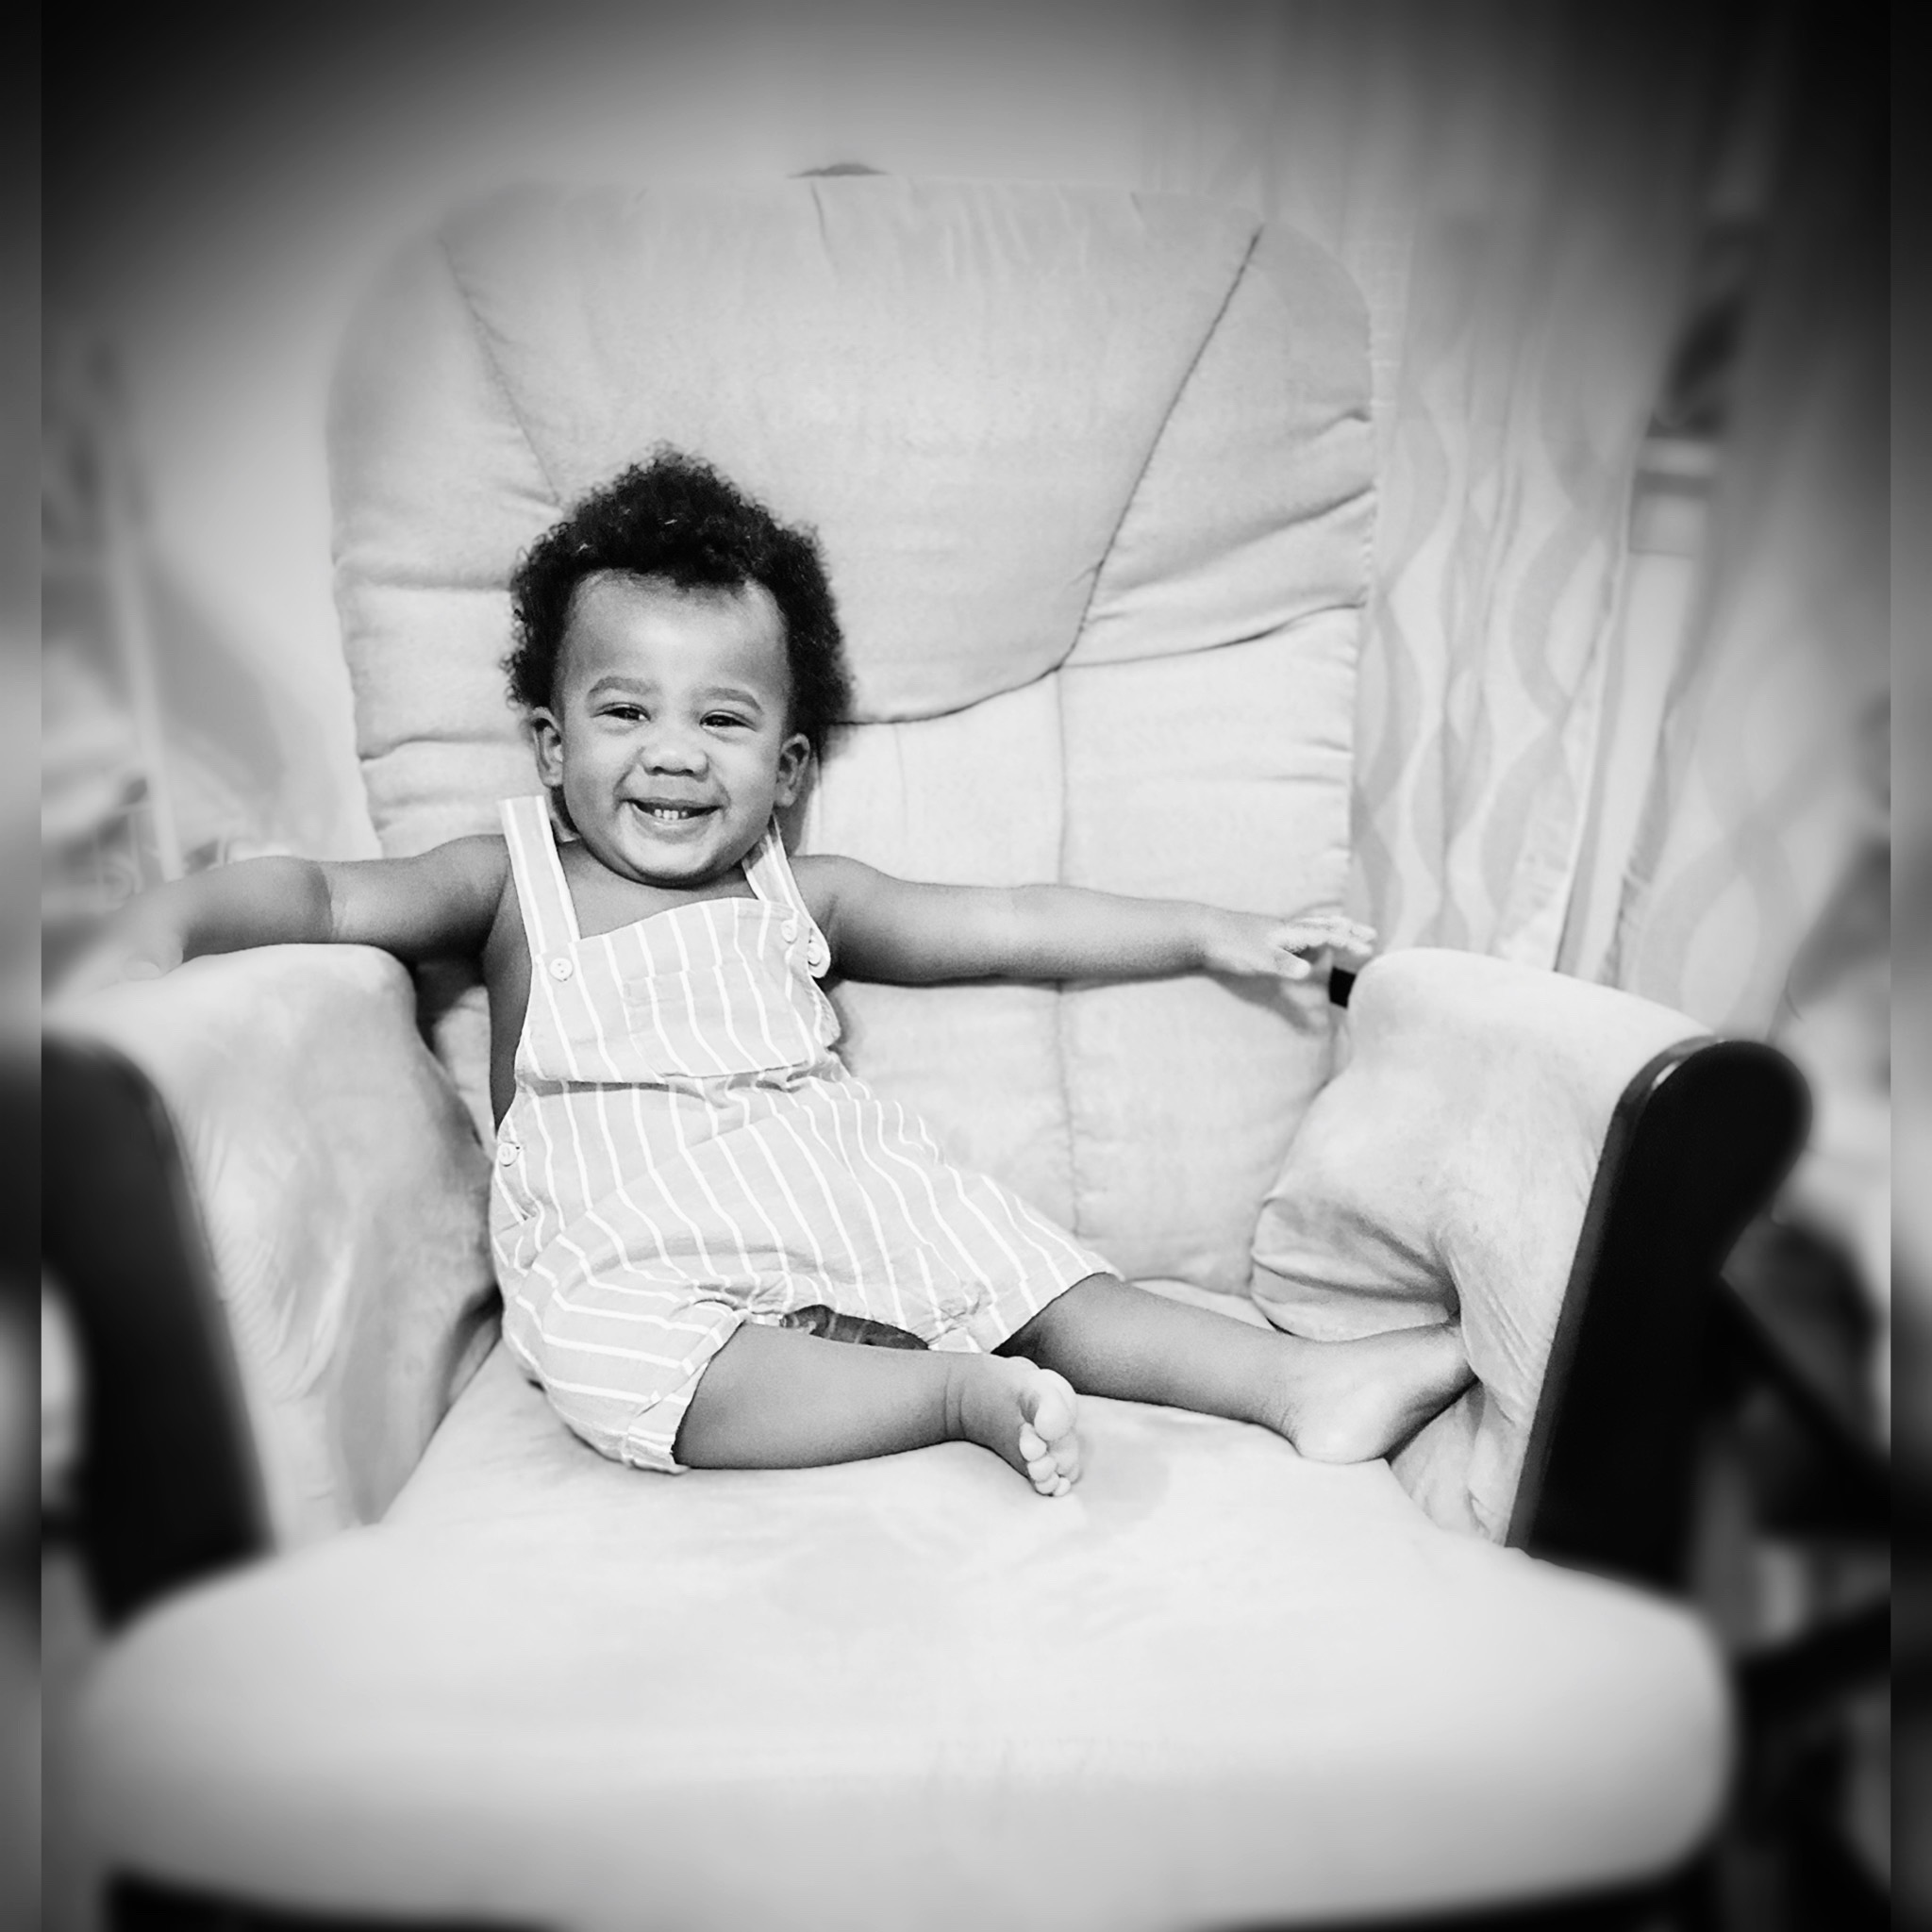
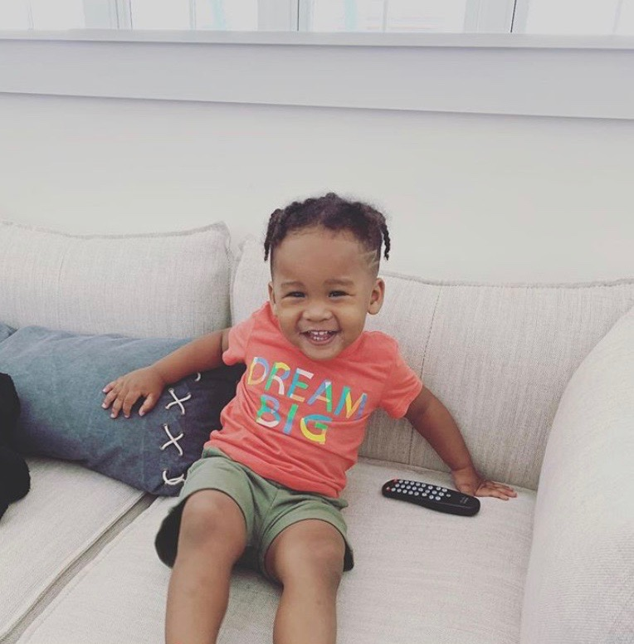


Ms. Norwood Likes:
Luca
Wilder
Luna

Slide 6
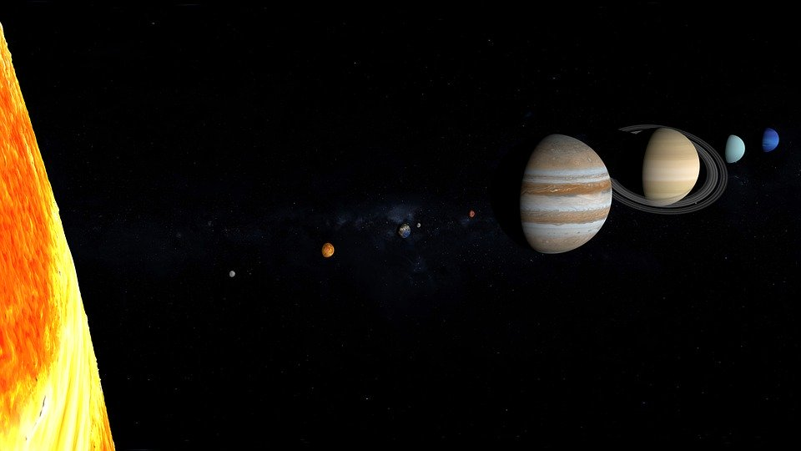
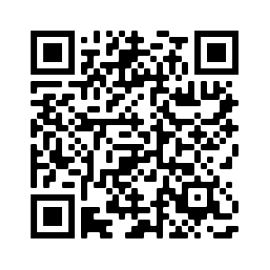
Classroom Information: itslearning LMS
Learning Management System
https://itslearning.com/global/about-us/resources/overview-video/
What is Its Learning?
ItsLearning is a cloud-based Learning Management System. This solution will provide parents, students, and staff a “one stop shop" for all things relating to curriculum and content management, instruction, tools for assessment and communication, and reporting and analytics. The system will integrate with 3rd party software and content providers to provide a seamless process for remote learning.
Your child will receive the same high-quality instruction they would receive under normal circumstances just through a virtual experience.
QR Code

Slide 7

A Typical Day in the Classroom
Arrive and Unpack
Morning Work
Pledge, National Anthem, Bear T.V. (morning announcements)
Morning Meeting (Calendar)
Eureka Math
Specials (Music, P.E. Spanish, Art)
Lunch
Wilson Fundations (Phonics/Word Work)
Flex Time (Individualized, targeted instruction)
Writing (6+1 traits)
Recess
Balanced Literacy (Read Aloud, Guided Reading/Small Groups)
Pack and snack

Slide 8

Classroom Information: Zoom
This is how we will hopefully meet as a class.
Join Zoom Meeting
https://us02web.zoom.us/j/85213612894?pwd=WTYwWXNGWlhFdk1idDV2VFZPa2U3dz09
Meeting ID: 852 1361 2894
Passcode: Bears20

Slide 9


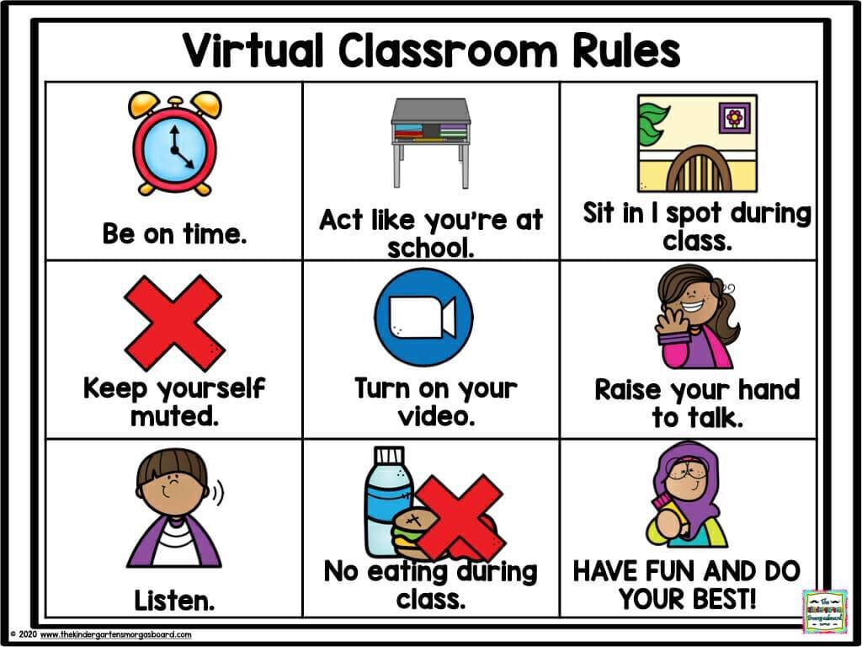
Virtual Learning Expectations

Slide 10
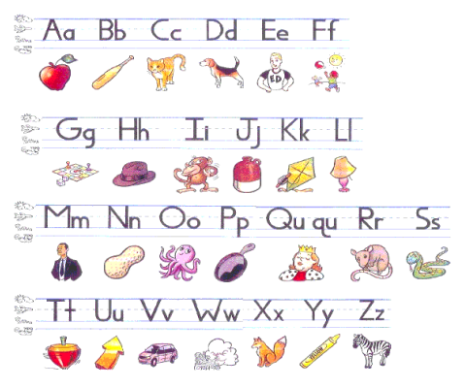

Classroom Information: Skills to work on
Learning Letters and Sounds
Fundations - Wilson Reading
Handwriting is
VERY important once
we learn how to form
and write each letter.

Slide 11

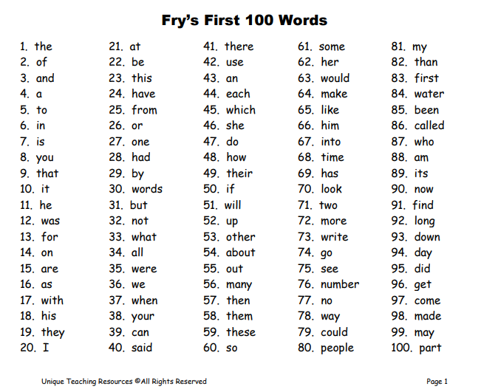
Classroom Information: Skills to work on
Learning Sight Words

Slide 12

Classroom Information: Skills to work on
Reading Books
There are many ways to read with your child. You can read to your child, have your child read to you, have your child read the pictures or have your child retell you a story.
When reading together it is great to stop and ask questions to work on comprehension. For example
Who are the characters (people, animals or creatures in the story)?
Where is the setting (where the story takes place)?
What is happening during the story -Beginning, Middle and End?
How do the characters feel?
What will happen next?
What was your favorite part and why?

Slide 13
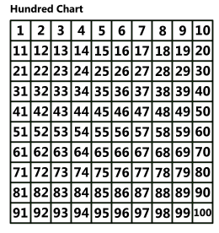

Classroom Information: Skills to work on
Counting to 100, 120 and skip counting

Slide 14

Classroom Information: Supply List
All students are required to use clear or mesh book bags.
1 one-inch black binder with protective sleeve cover
1 plastic folder with 3 prongs and 2 pockets
1 primary composition book for grades K-2 (will say primary composition book on the front)
1 wide-ruled composition notebook (marbled cover)
1 supply box (8.5” X 5”)
2 24-packs of Dixon Ticonderoga pencils *
3 boxes of Crayola crayons (24 count) *
1 box of Crayola Classic Colors Markers (no skinny markers) *
2 ten-packs of glue sticks *
1 package EXPO dry erase markers with eraser *
1 pair of Fiskars scissors *
1 pair of headphones (not earbuds)
2 large boxes of tissues
1 ten-ounce bottle of hand sanitizer
A change of uniform clothing with undergarments (to be kept in the book bag)
*Please pay attention to the brand names requested. Although the brand may be more expensive, we have learned over the years that they last longer and/or work better, saving you money in the long run.

Slide 15

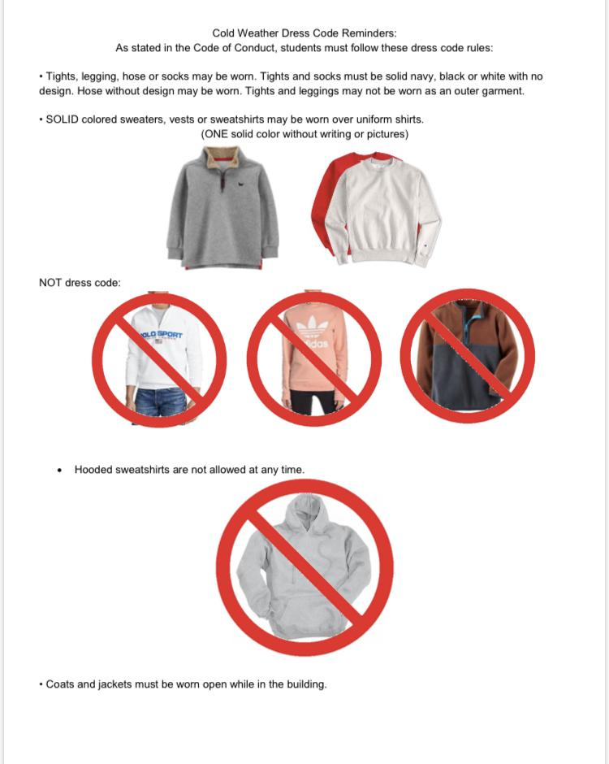
Classroom Information: Dress Code
Shirt/Blouse Hunter Green or White
Bottoms Khaki or Navy
Socks/Tights/Leggings SOLID White, Navy, or Black
Undershirts (if worn) MUST be SOLID white.
Hoodies that do not unzip are NEVER allowed.
Sweaters & jackets worn in building MUST be SOLID hunter green, navy, black, or white.
Belts (if worn) must be navy, black, or brown.
Shoes MUST have fully-enclosed toe.
Practice shirt-tucking and tying their shoes!

Slide 16

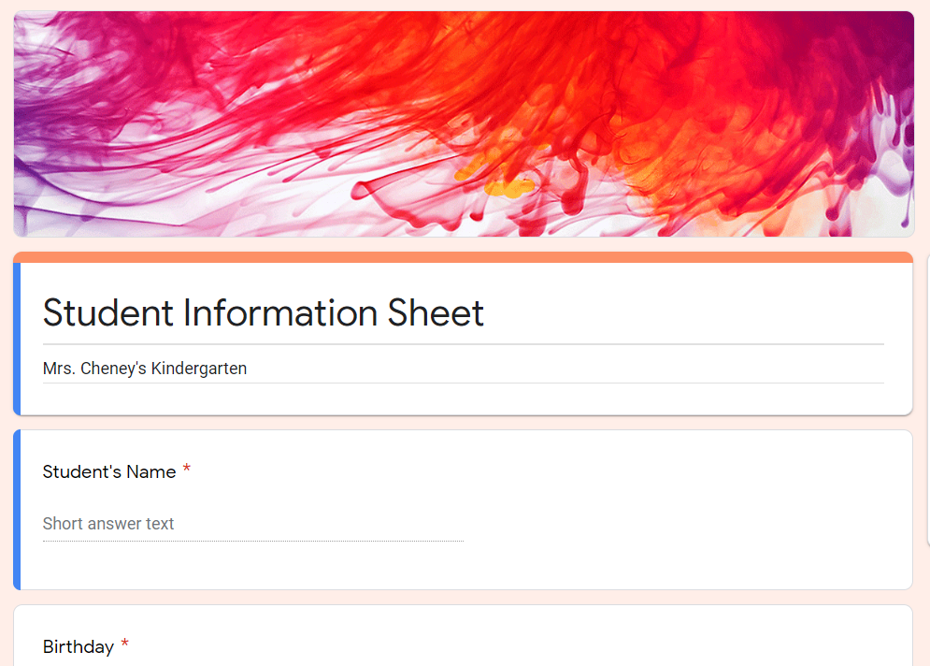
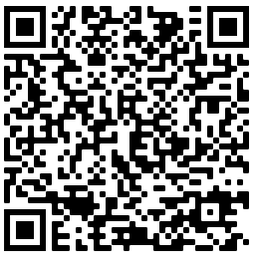
Student Information
Please fill out the student information google form
https://docs.google.com/forms/d/e/1FAIpQLSdzN91yu0RGHfOmgm687BJzXWx66FnGoz0bx_mifQON_tQ3ng/viewform?usp=sf_link
QR Code

Slide 17
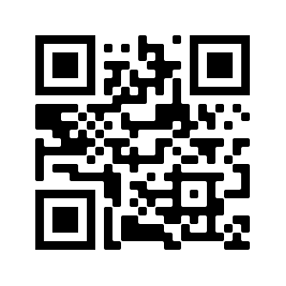

Contact Information
QR Code
Website: https://rcheney.weebly.com/
Email: regan.cheney@sccpss.com
Office: 912-395-6440
Class Dojo - more information will
be sent through email

