Slide 1
Hesse K-8 is the P.L.A.C.E. to Be!
2020-2021 Virtual Open House
Hesse K-8 School

Slide 2
Greetings from Principal Newman
Kimberly Newman, Hesse K8 Principal
kimberly.newman@sccpss.com
MISSION POSSIBLE: Blasting Off to New Explorations!

Slide 3
Meet our Assistant Principals.
Erica Ross
Grades PK-4
Jennie Thompson
Grades 5-8
Erica.ross@sccpss.com
jennie.thompson@sccpss.com

Slide 4
Meet our Pre-K and Kindergarten Teachers and Paraprofessionals.

Slide 5
District Information
Savannah-Chatham County Public School System website can be found here:
https://spwww.sccpss.com/Pages/default.aspx
Virtual School Reopening Guidance
https://spwww.sccpss.com/Pages/School-Reopening-Guidance.aspx
Parent Guidance Document
https://spwww.sccpss.com/Documents/PARENT%20GUIDE%20booklet%20SY2020%202021%20VIRTUAL%20LEARNING882020.pdf
QR Code
QR Code

Slide 6
Hesse Information
Hesse K-8 Website
http://internet.savannah.chatham.k12.ga.us/schools/Hesse_Elementary/default.aspx
QR Code

Slide 7
Hesse K-8 Place-Based Learning Themes
Pre-K and K: Farm to School
1st Grade: Respecting the Environment
2nd Grade: Impact of Organisms on the Environment
3rd Grade: Preserving Coastal Ecosystems
4th Grade: Aeronautics
5th Grade: Patterns in Nature
6th Grade: Natural Disasters
7th Grade: Ecosystems
8th Grade: Engineering
Incorporating
STEAM
(Science, Technology, Engineering, Art, Math)
into our classrooms through
Place-Based Learning.

Slide 8
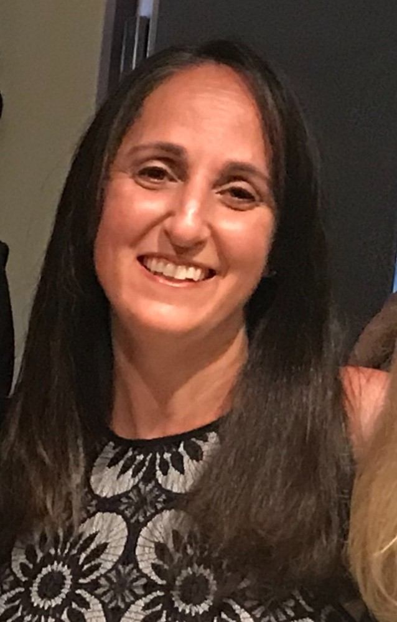
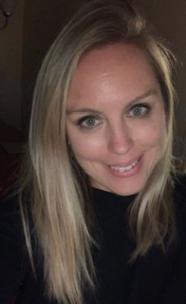
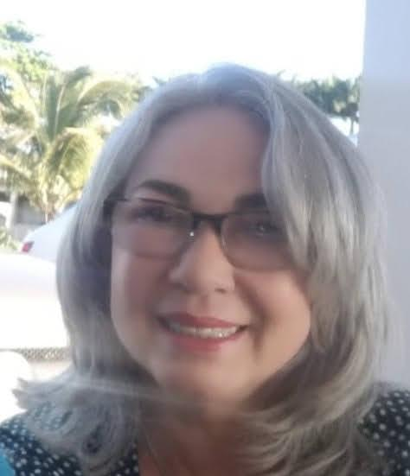
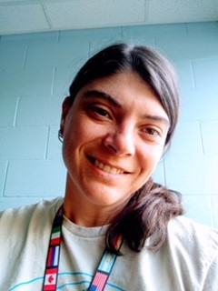
ESOL : Escuela Primaria y Media ESOL- English to Speakers of Other Languages Program
Visite el sitio web de ESOL: https://sites.google.com/sccpss.com/hesseesol/home
Escuela Primaria / Elementary School |  |  |  |  |  |  | Escuela Media / Middle School
Pre-escolar / Kindergarten |  | 1º Grado | 2º Grado | 3º Grado | 4º Grado | 5º Grado | 6º Grado | 7º Grado | 8º Grado
Ms. Rhaquay Youmans
ESOL Teacher
Escuela Primaria rhaquay.youmans @ sccpss.com
Ms Cherie Dennis
ESOL Teacher Escuela Primaria
Cherie.Dennis@ sccpss.com
Ms Amanda Wooten
ESOL Teacher
Escuela Primaria
Amanda.Wooten@sccpss.com
Ms Kelli
Lawson
ESOL Teacher
Escuela Media
kelli.lawson@ sccpss.com
Click on your teacher’s name to see a video introduction
Haga clic en el nombre de su maestro para ver un video de introducción
Ms Lillibeth Hornedo
ESOL para
Escuela Media
lillibeth.hornedo@ sccpss.com

Slide 9
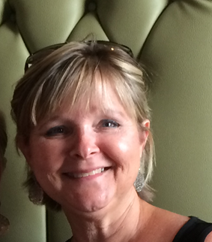
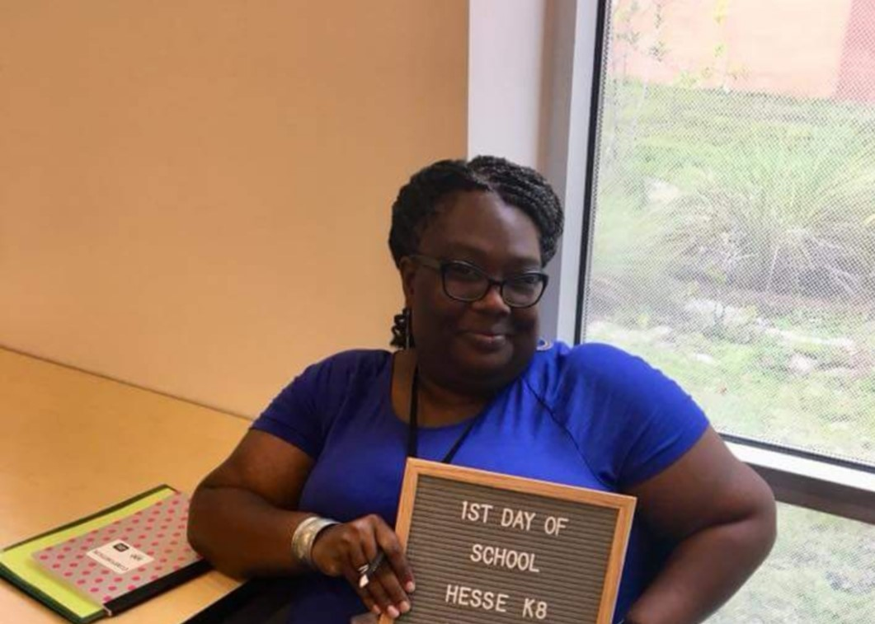
Hesse Information: EIP
EIP TEACHERS
Hesse K8
Early Intervention Program
Ms. Shavin Richmond
Mrs. Cecilia Stamper
During the school year if you are notified that your child is eligible for EIP services please review this link to learn more about the program.
https://docs.google.com/presentation/d/1zl7Yqv9xcK6mbAolUVVHKbnyLZ0xphIcNXFTT8ZZpEY/edit?usp=sharing

Slide 10
Hesse: Meal Information
Who will have access to school meals?
THE MEALS ON THE BUS GO ROUND AND ROUND! All SCCPSS students will be provided school meals throughout the virtual learning model. When school starts, each week on a designated day, meals will be delivered by school buses traveling across Chatham County. ​Parents and guardians will have through Sept. 30 to complete the application process for free and reduced meals, but if an application has not been fully processed, an alternative meal will be available, so no child goes without food.
https://www.myschoolapps.com/Home/PickDistrict
QR Code
*****Watch for more information in the meal survey email that should have been sent to you.

Slide 11
Hesse: WHO TO CONTACT FOR ASSISTANCE:
REGISTRATION/POWER SCHOOL QUESTIONS: (912) 395-6440
Michelle Conner, Secretary laurie.conner@sccpss.com
Melissa Fields, Secretary melissa.fields@sccpss.com
Robin Steplight, Administrative Secretary robin.steplight@sccpss.com
Cookie Brookshire, Information Specialist Cookie.brookshire@sccpss.com

Slide 12
Hesse: WHO TO CONTACT FOR ASSISTANCE:
TECHNOLOGY ASSISTANCE: (912) 395-6440
Donna Sikes, Media Specialist donna.rudser-Sikes@sccpss.com

Slide 13
Hesse: WHO TO CONTACT FOR ASSISTANCE:
FAMILY SUPPORT: (912) 395-6440
Mark Fordham, PK-2nd grade Counselor mark.fordham@sccpss.com
Stephanie Small, 3rd-5th grade Counselor stephanie.small@sccpss.com
Bathsheba Cherry, 6th-8th grade Counselor bathsheba.cherry@sccpss.com
Stacey Reid, School Social Worker stacey.reid@sccpss.com
Erin Miller, School Nurse erin.miller@sccpss.com
Samantha Ramsey, School Nurse samantha.ramsey@sccpss.com

Slide 14
Hesse: WHO TO CONTACT FOR ASSISTANCE: Stacy Reid - School Social Worker

Slide 15
Hesse: K8 PTA Membership
Please support your school by joining Hesse K8 PTA…
Michele Smith, PTA President presidenthessek8pta@gmail.com
Join PTA today! Memberships are $5 per person.
Use the link below to join online.
https://hessek8pta.memberhub.store/
Don’t HIBERNATE…. PARTICIPATE!!

